Slide 1
Taku A

Slide 2
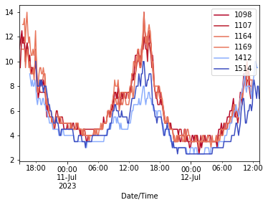
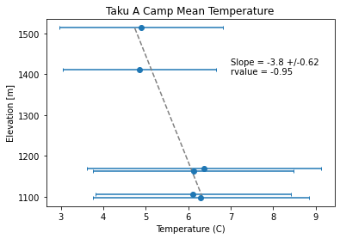
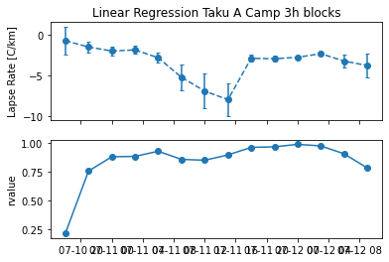

Slide 3
Taku B

Slide 4
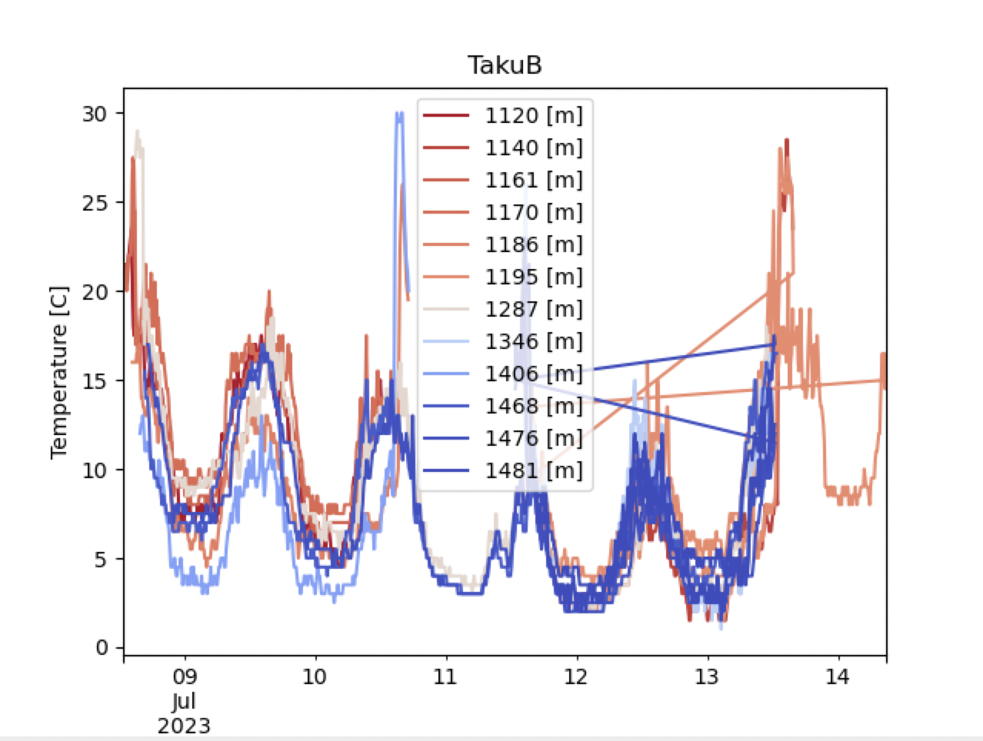
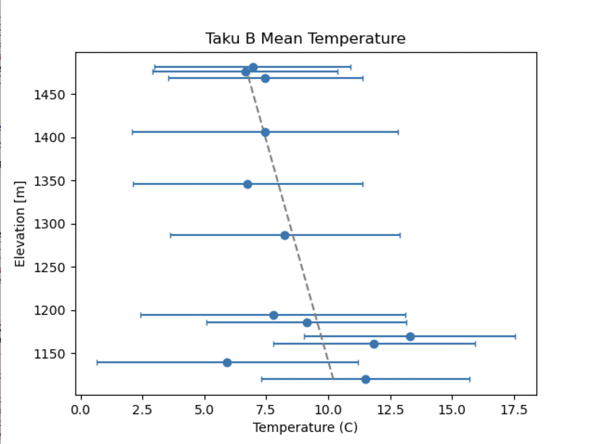

Slide 5
Heather

Slide 6
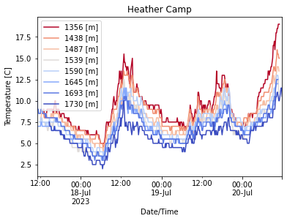
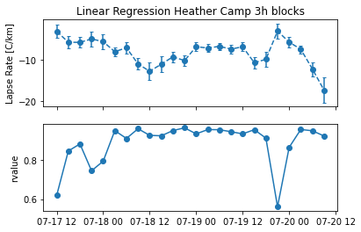
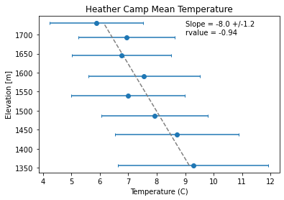

Slide 7
C18 Vert

Slide 8
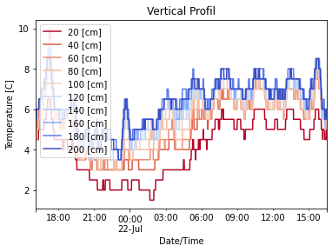
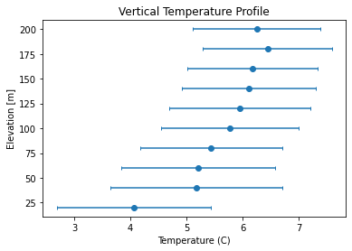

Slide 9
C18 to C8

Slide 10

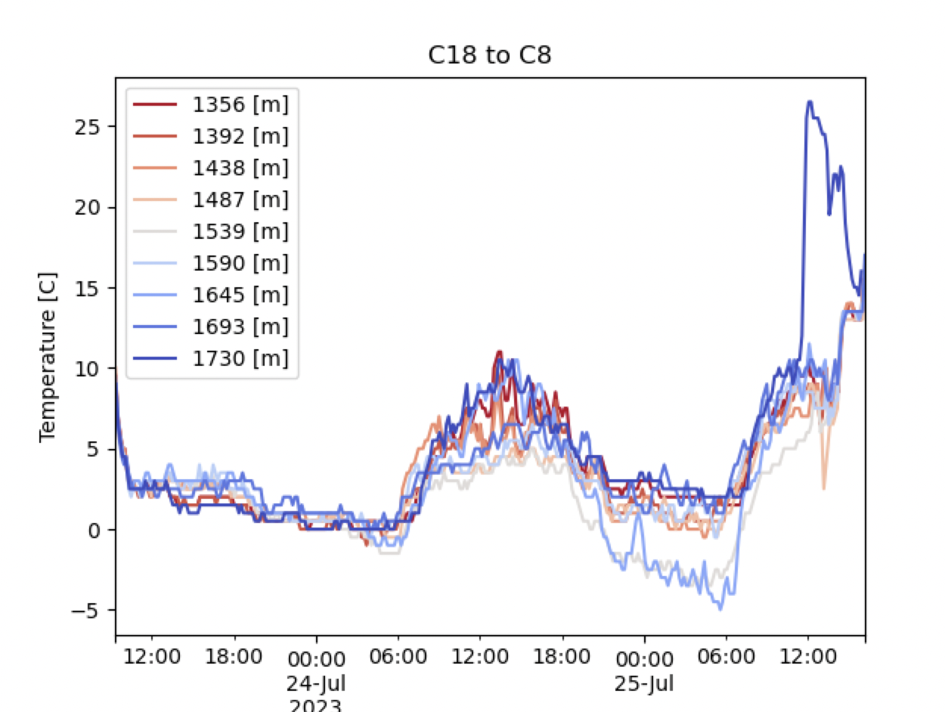
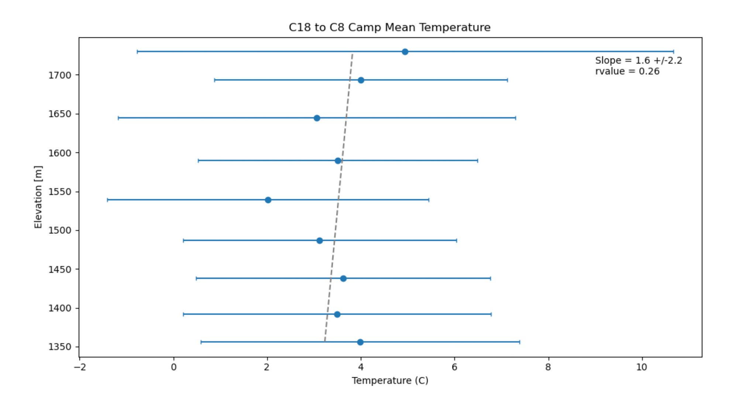

Slide 11
C9 to C18

Slide 12
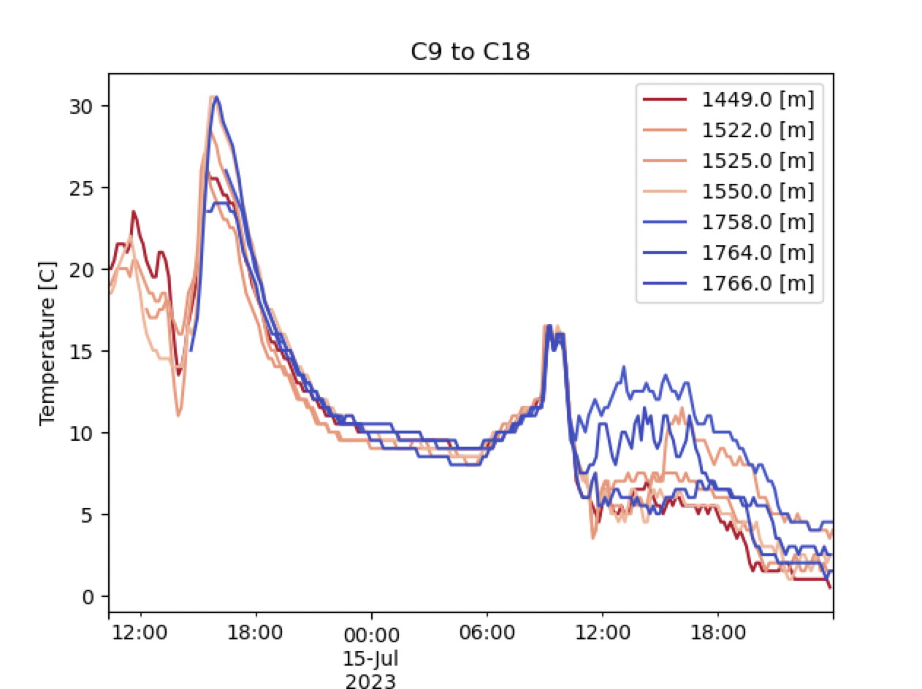
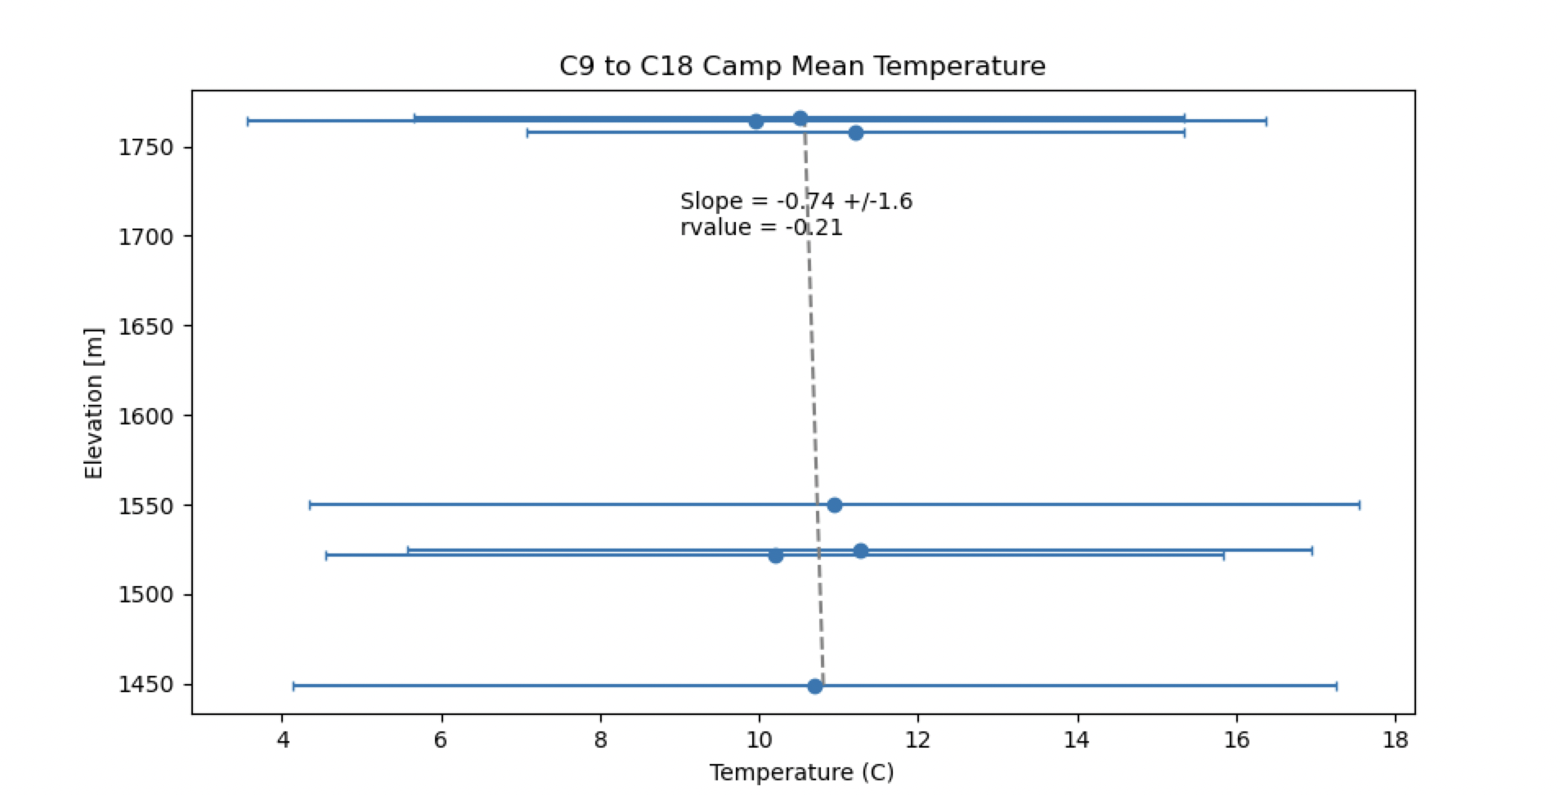

Slide 13
C8 Transect

Slide 14
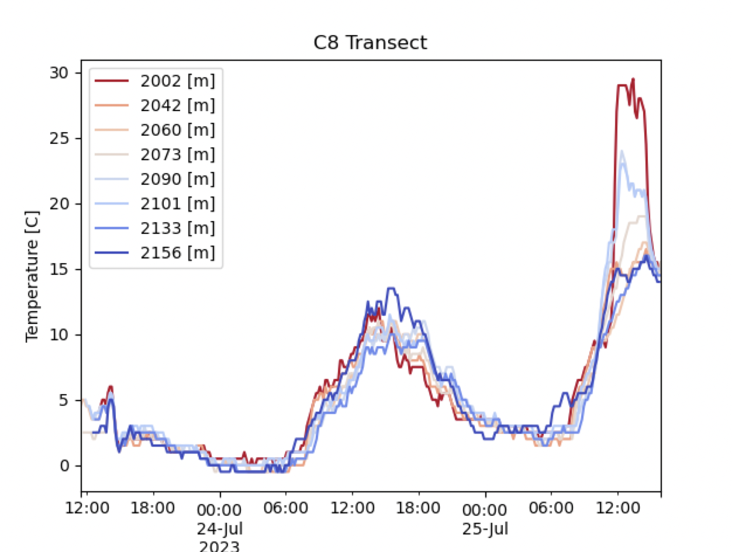
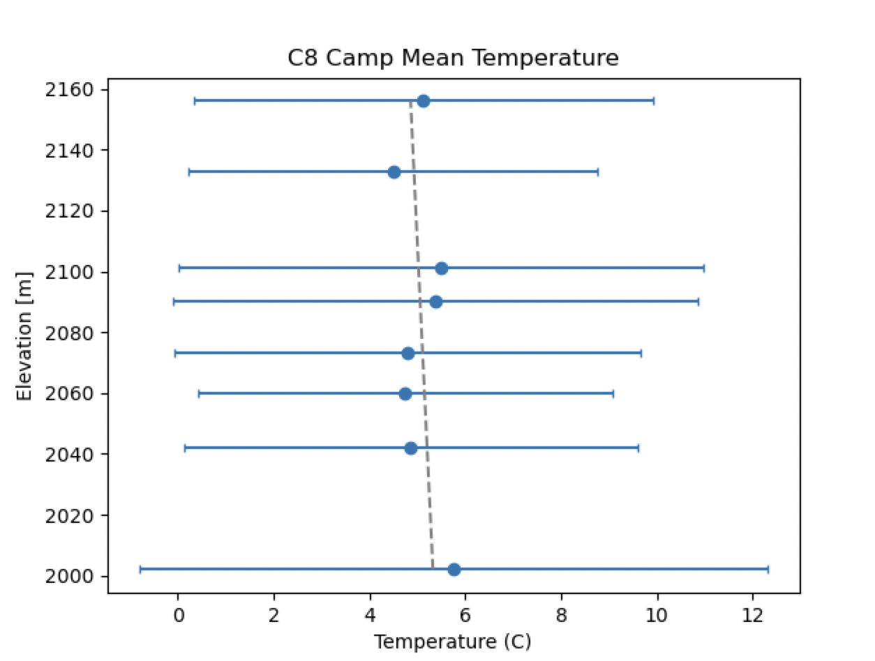

Slide 15
 | Slope | Uncertainty (+/-) | Rvalue
Taku A | -3.8 | 0.62 | -0.95
Taku B | -9.8 | 4.3 | -0.59
Heather | -8 | 1.2 | -0.94
C18 Vert
C18 to C8 | 1.6 | 2.2 | 0.26
C9 to C18 | -0.74 | 1.6 | -0.21
C8 Vert | -3 | 3.3 | -0.35

